Slide 1


Code Academy AzMF201
Fuad Mammadov

Slide 2
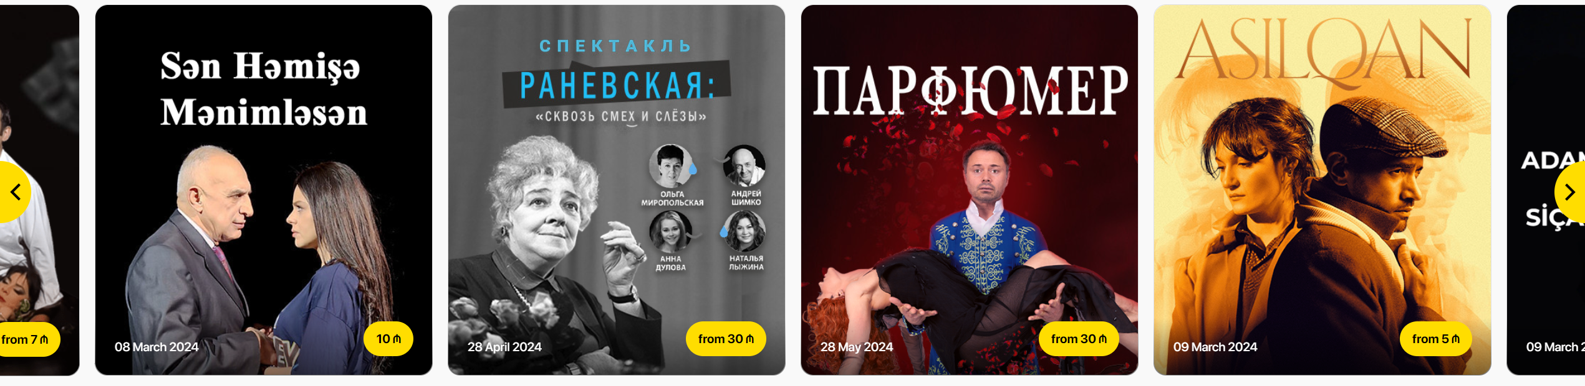

Home Page
Wishlist.
Events slider.
Popular.

Slide 3
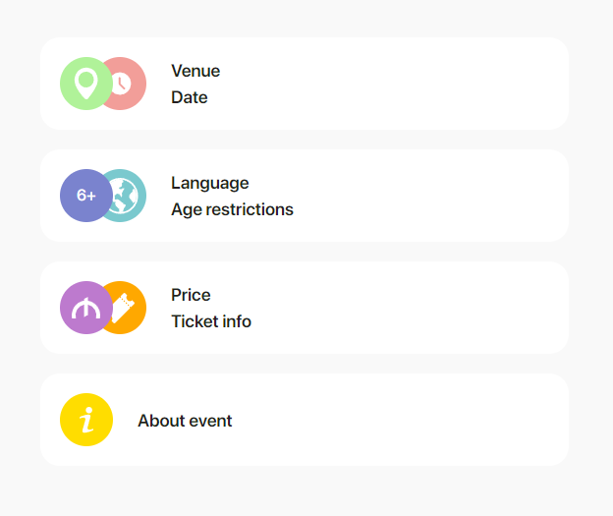
Detail Page
Venue.
Language.
Age restrictions.
About event

Slide 4
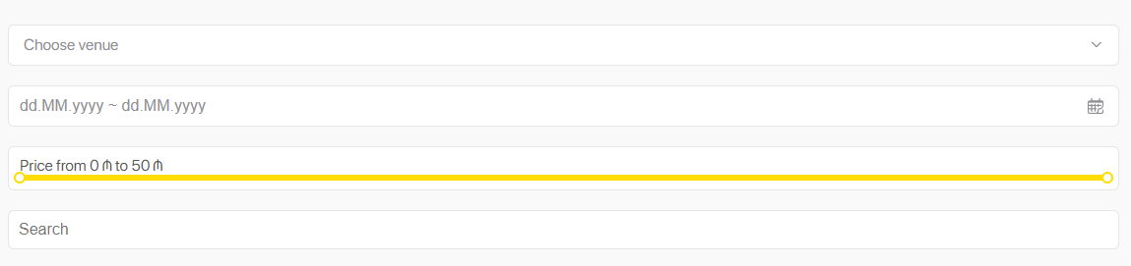
Category Page
Venue Filter.
Date Range Filter.
Price Filter.
Filter By Category.
Search.
Pagination.

Slide 5
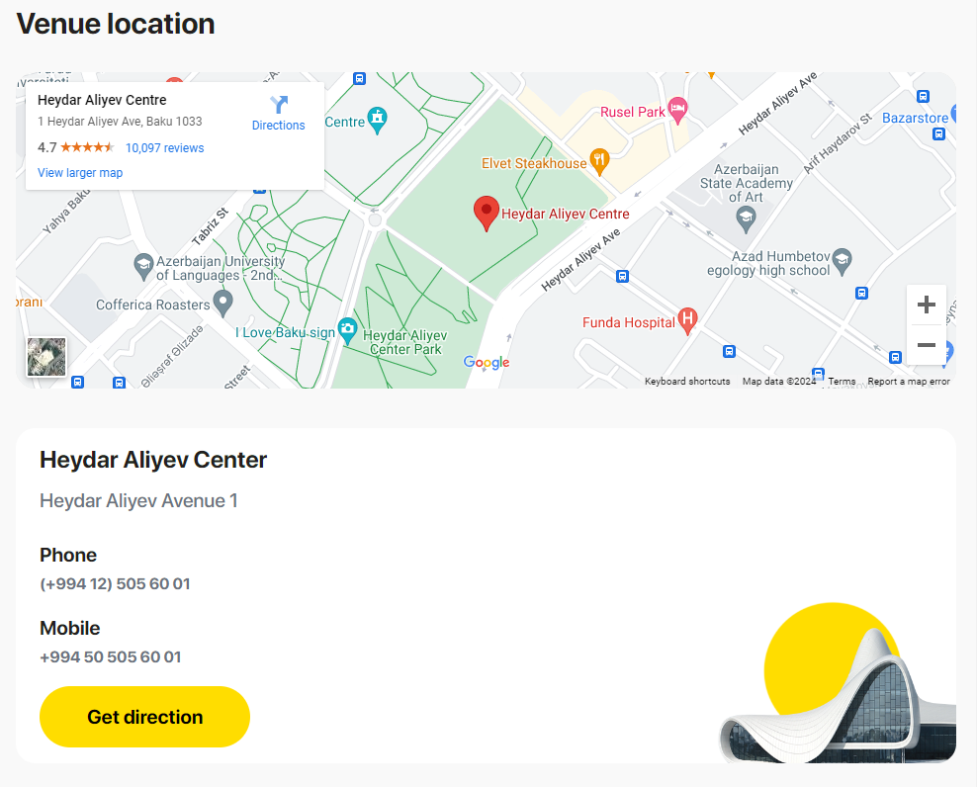
Venue
Embedded map.
Title.
Address.
Phone.
Mobile.
Link.

Slide 6







FrontEnd technologies
React Formik
React Suite
React
Vite

Slide 7





BackEnd technologies
820303

Slide 8
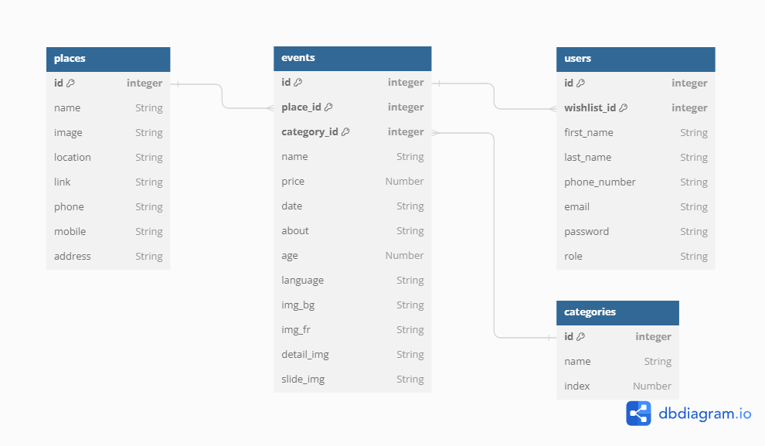
MongoDB diagram

Slide 9

thanks

